Slide 1
Coordinate systems and transforms in IGT

Slide 2
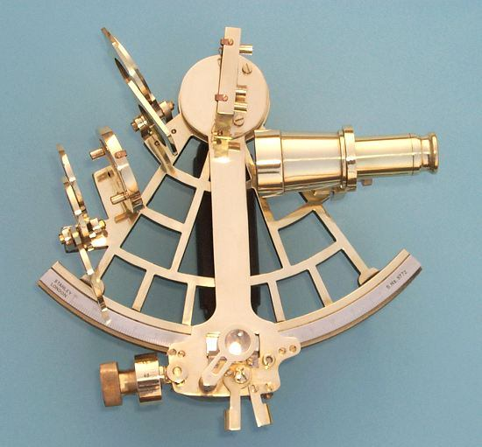
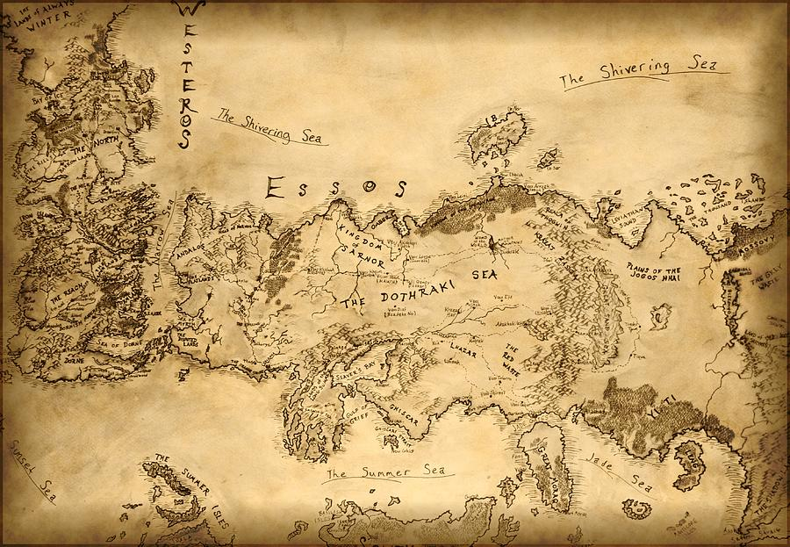
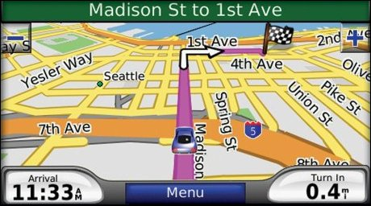
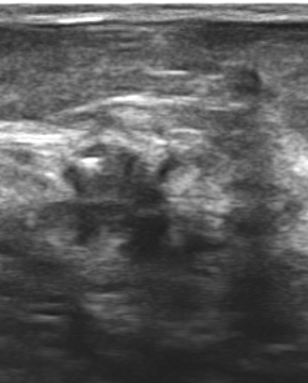
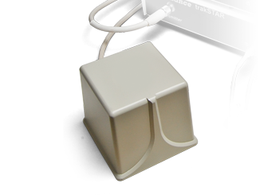
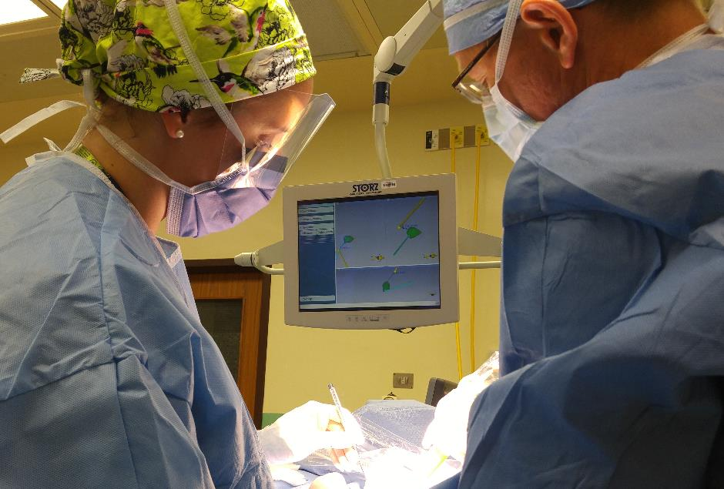
Navigation
Registration
Data collection
Visualization

Slide 3
The Train Fly Problem
Two trains are on the same track 100 km apart heading towards one another, each at a speed of 20 km/h. A fly starting out at the front of one train, flies towards the other at a speed of 40 km/h. Upon reaching the other train, the fly turns around and continues towards the first train. This is repeated until the two trains crash and the fly is annihilated. How many kilometers does the fly travel before the crash?

Slide 4
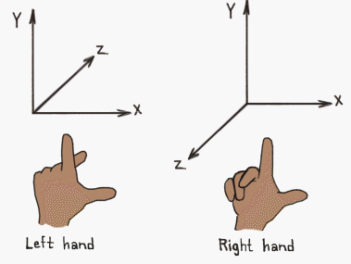
Coordinate system
- Where is a point?
- (X,Y,Z)
- Where is (0,0,0)?
- Which direction is X, Y, and Z?
- How much is 1?
Y
X
Z
Remember: define coordinate systems
Use right-handed
Tell origin
Tell directions
Tell units

Slide 5
Where is the probe?
Y
Attach a coordinate system to everything that is not rigidly fixed to an already existing coordinate system.
Name coordinate systems consistently.
Define points WITH respect to coordinate systems.
Probe
X
Z
Relative to what?
Y
Note:
There is no absolute "world" coordinate system!
Tracker
X
Z

Slide 6
Coordinate transform
Probe-To-Reference-Transform
Transforms
describe every linear spatial relationship
internally represented by 4x4 matrices
concatenated by matrix multiplication
Y
Y
Probe
Reference
X
X
Z
Z
Tracker-To-Reference-Transform
P→R = T→R * P→T
Y
Probe-To-Tracker-Transform
Tracker
X
Z

Slide 7
Transform
Y
Types of transforms
Rigid
Translation
Rotation
Similarity
Isotropic scaling
Affine
Anisotropic scaling, skew
Deformable (non-linear)
One
X
Z
OneToOtherTransform
Y
Other
X
Z

Slide 8
Transforms (PLUS)
All transforms are defined by the names of the two coordinate systems that it transforms between:
<FromCoordinateSystem>To<ToCoordinateSystem>Transform = <Rxx> <Rxy> <Rxz> <Tx>
<Ryx> <Ryy> <Ryz> <Ty>
<Rzx> <Rzy> <Rzz> <Tz>
0 0 0 1
where
[ Position_in_ToCoordinateSystem_x ] = [ Rxx Rxy Rxz Tx ] * [Position_in_FromCoordinateSystem_x ]
[ Position_in_ToCoordinateSystem_y ] [ Ryx Ryy Ryz Ty ] [Position_in_FromCoordinateSystem_y ] [ Position_in_ToCoordinateSystem_z ] [ Rzx Rzy Rzz Tz ] [Position_in_FromCoordinateSystem_z ] [ 1 ] [ 0 0 0 1 ] [ 1 ]

Slide 9
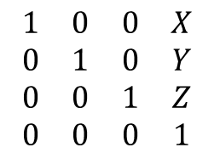
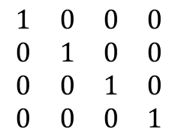
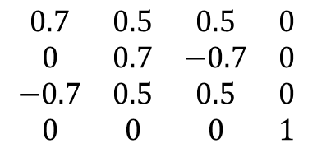
Commonly used
$$\begin{matrix}1 & 0 & 0 & 0 \\ 0 & 1 & 0 & 0 \\ 0 & 0 & 1 & 0 \\ 0 & 0 & 0 & 1\end{matrix}$$
"Identity transform"
Does nothing
$$\begin{matrix}1 & 0 & 0 & X \\ 0 & 1 & 0 & Y \\ 0 & 0 & 1 & Z \\ 0 & 0 & 0 & 1\end{matrix}$$
"Translation"
Pushes away
$$\begin{matrix}0.7 & 0.5 & 0.5 & 0 \\ 0 & 0.7 & −0.7 & 0 \\ −0.7 & 0.5 & 0.5 & 0 \\ 0 & 0 & 0 & 1\end{matrix}$$
"Rotation"

Slide 10
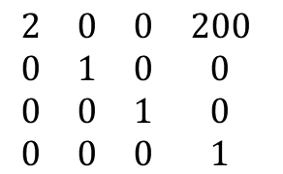
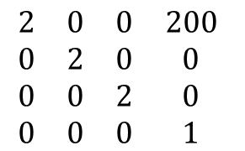
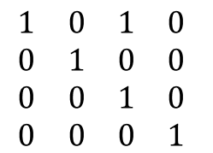
Careful with these!
$$\begin{matrix}2 & 0 & 0 & 200 \\ 0 & 2 & 0 & 0 \\ 0 & 0 & 2 & 0 \\ 0 & 0 & 0 & 1\end{matrix}$$
"Scaling"
(and translation)
$$\begin{matrix}2 & 0 & 0 & 200 \\ 0 & 1 & 0 & 0 \\ 0 & 0 & 1 & 0 \\ 0 & 0 & 0 & 1\end{matrix}$$
Anisotropic
scaling
(and translation)
$$\begin{matrix}1 & 0 & 1 & 0 \\ 0 & 1 & 0 & 0 \\ 0 & 0 & 1 & 0 \\ 0 & 0 & 0 & 1\end{matrix}$$
"Skew"
(and translation)

Slide 11
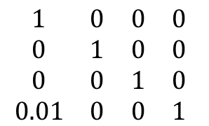
$$\begin{matrix}1 & 0 & 0 & 0 \\ 0 & 1 & 0 & 0 \\ 0 & 0 & 1 & 0 \\ 0.01 & 0 & 0 & 1\end{matrix}$$

Slide 12
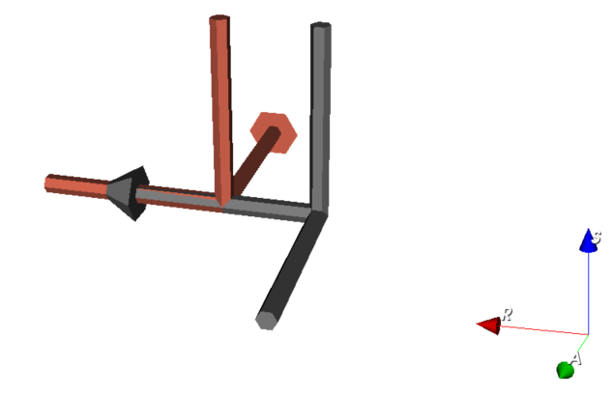
Rotation + translation
1.
2.
0 1 0 10
-1 0 0 0
0 0 1 0
0 0 0 1
The translation part always indicates the origin of the transformed coordinate system in the original coordinate system.

Slide 13
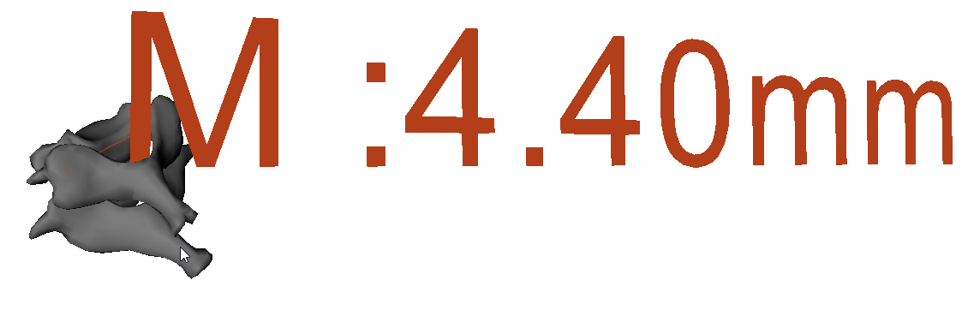
I got a surface model (STL file) in centimeter units. But 3D Slicer assumes millimeters
What transform would convert it to millimeters?

Slide 14
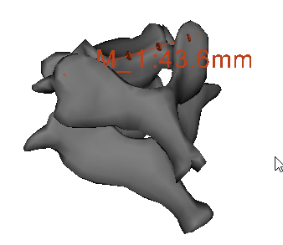
I got a surface model (STL file) in centimeter units. But 3D Slicer assumes millimeters
What transform would convert it to millimeters?
CmToMm
10 0 0 0
0 10 0 0
0 0 10 0
0 0 0 1

Slide 15
Where do transforms come from?
Tracker device
Registration procedure
"Real-time"
Find
handedness
units
Get an idea about
origin
axes
Stay constant until next registration

Slide 16
Registration
Y
How do you find a constant transform?
Manual trials
Landmark (point) registration
Image registration
Reference
X
Z
Tracker-To-Reference-Transform
Landmark registration
Horn, 1987
Closed form solution
Min 3 points (+handedness)
a.k.a. "fiducial registration"
Y
Tracker
X
Z

Slide 17
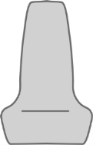
What we call "calibration"
Registration between internal parts of objects
Constant relationship
Y
Probe
Y
X
Z
Stylus
Y
Y
X
Z
Image
X
Z
StylusTip
X
Z

Slide 18
Programming transforms
Transforms can be stored in many variable types
vtkMatrix4x4 – SetElement and GetElement can get confusing
python list of lists – Confusing, no methods to operate
numpy.array – Great for numerical methods
vtkTransform – Great for understandable code
etc.
# Create a transform node (unless already exists) that translates
referenceToRasTransform = vtk.vtkTransform()
referenceToRasTransform.Translate(30, 10, 0)
referenceToRas = slicer.util.getNode('ReferenceToRas')
if referenceToRas is None:
referenceToRas = slicer.vtkMRMLLinearTransformNode()
referenceToRas.SetName('ReferenceToRas')
slicer.mrmlScene.AddNode(referenceToRas)
referenceToRas.SetAndObserveTransformToParent(referenceToRasTransform)

Slide 19
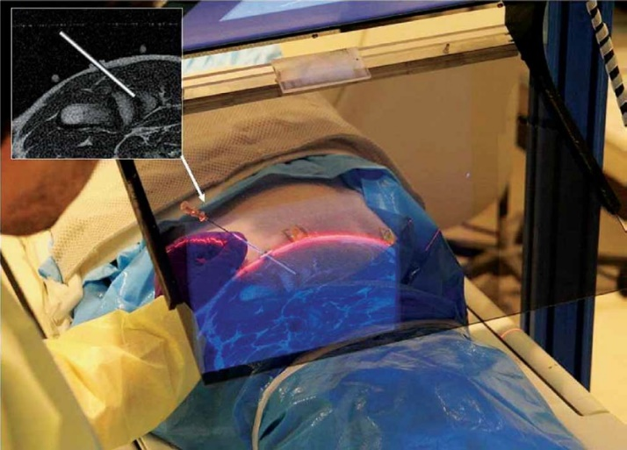
Example: Image overlay
Overlay frame
calibration
Display reflection
calibration
In-room Display
RAS
IJK
CT image
coordinates
Virtual Display
In-plane
calibration
Overlay

Slide 20
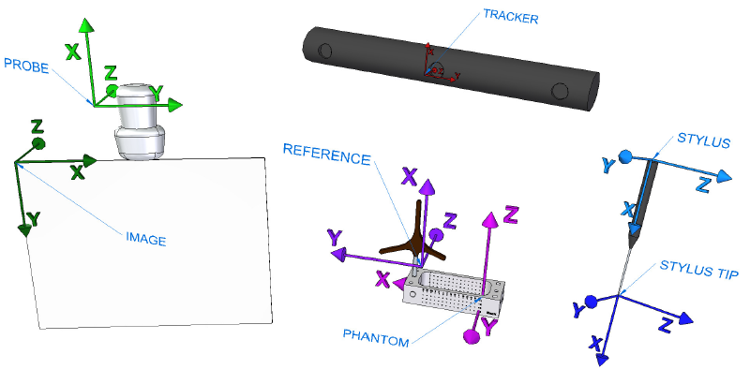
Coordinate systems in PLUS

Slide 21
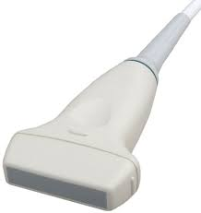
Example: Breast tumor tracking
Probe
Cautery
Needle
Needle
Image
CauteryTip
Reference
Tumor
Tumor
RAS

Slide 22
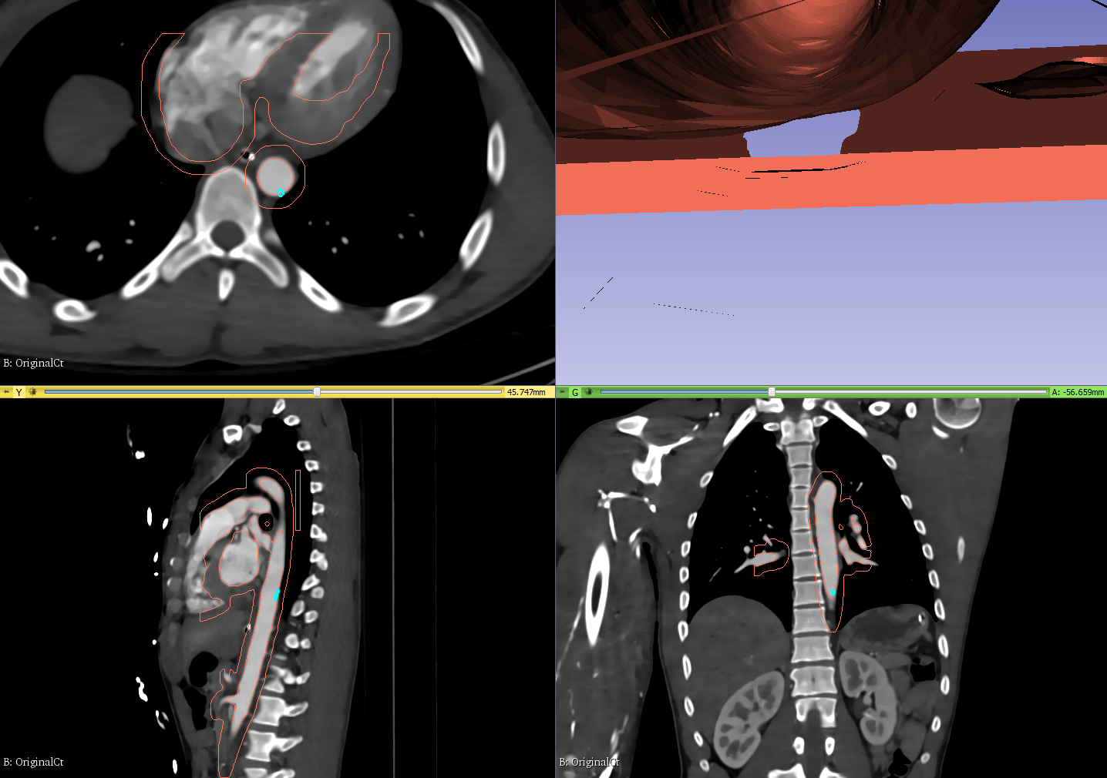
Virtual endoscopy view

Slide 23
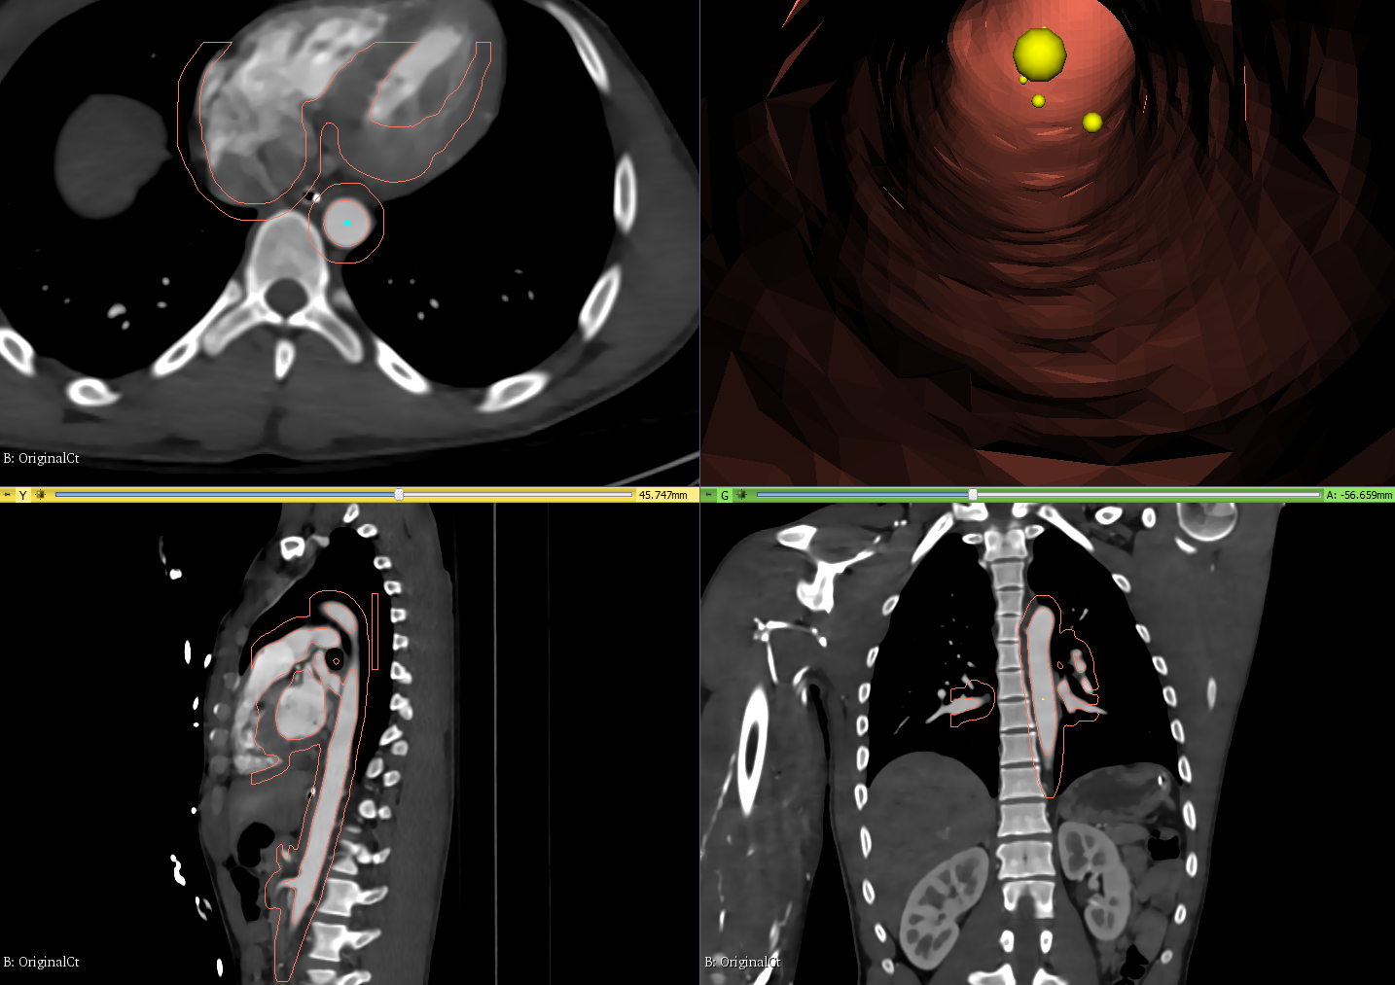
Snap camera to centerline

Slide 24
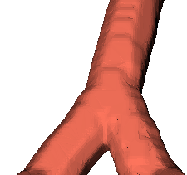
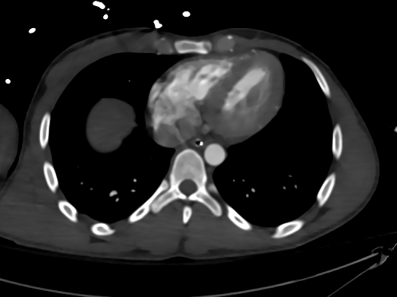
How would you change this?
Catheter
Camera
Reference
RAS

Slide 25
Adding snap to camera transform
Catheter
Path
Camera
Reference
RAS

Slide 26
Compute PathToCatheter
catheterToRas = vtk.vtkGeneralTransform()
catheterToReferenceNode.GetTransformToWorld(catheterToRas)
cathPosition_Cath = numpy.array([0.0, 0.0, 0.0])
cathPosition_Ras = catheterToRas.TransformFloatPoint(cathPosition_Cath)
pathPoint_Ras = numpy.array([0.0, 0.0, 0.0])
self.logic.closestPointFiducials(pathFids_Ras, cathPosition_Ras, pathPoint_Ras)
rasToCathether = vtk.vtkGeneralTransform()
catheterToReferenceNode.GetTransformToWorld(rasToCathether)
rasToCathether.Inverse()
pathPoint_Cath = rasToCathether.TransformFloatPoint(pathPoint_Ras)
pathToCatheterTransform = vtk.vtkTransform()
pathToCatheterTransform.Translate(
pathPoint_Cath[0], pathPoint_Cath[1], pathPoint_Cath[2])

